Slide 1

Location Analysis for Shopping Malls in Hyderabad
BY Siva Chaitanya M

Slide 2
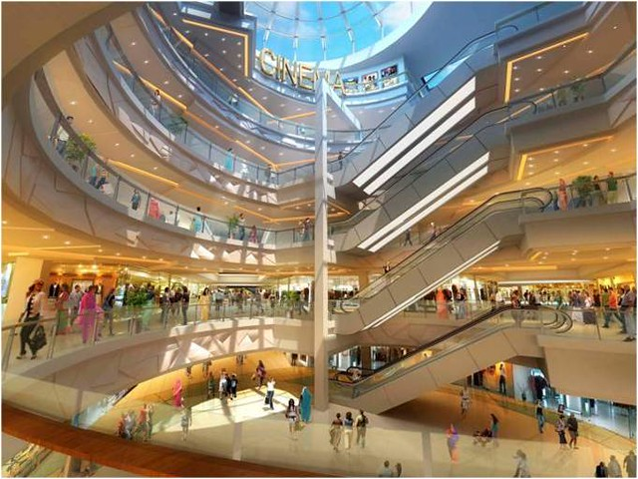
Introduction
With shopping mall industry seeing a boom in their business, people started indulging more in weekend movies, shopping and recreational events happening in and around their localities.
In metropolitan cities, especially in densely populated ones like Hyderabad, this has been especially true.
Businesses also gain a lot of exposure and potential from setting up a stall/shop in one of the shopping malls in any area.
And so, this project aims to analyze the current shopping mall scenario which is a crucial step in the protocol of opening a new shopping mall in any city.

Slide 3

Problem Statement
What is my competition for opening up a new shopping mall in Hyderabad ?
Which area/localities have the most potential for customers and revenue generation ?
As shopping malls contain huge variety of businesses within them, it is important to understand the level of uncertainty in the market they are faced with from their peers.
Competition makes or breaks a business. Competition impacts a company’s business strategy.

Slide 4

Data Resources & Tools
Resources
Libraries & APIs
For list of neighborhoods in and around Hyderabad, Wikipedia article: List of neighbourhoods in Hyderabad – Wikipedi
For obtaining geospatial data about the neighborhoods and venues around them: Geocoder, Foursquare
Pandas
BeautifulSoup
Geopy
Geocoder API
Folium
Foursquare API

Slide 5
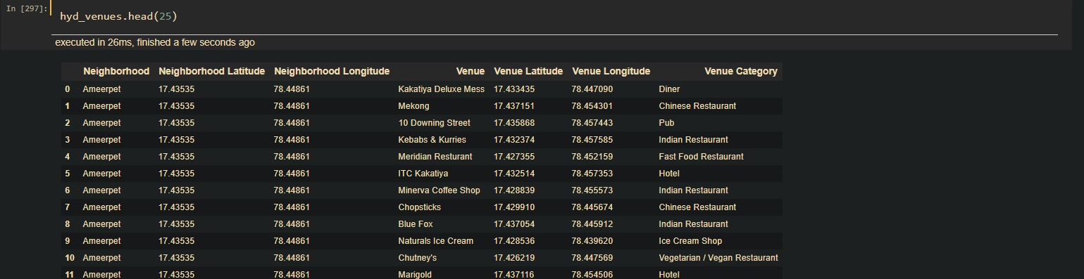
Methodology
Briefly, methodology for the project consists of the following steps:
Data procurement and Cleaning: In this we obtain all the necessary data about the different neighborhoods from the Wikipedia page using BeautifulSoup library and their geospatial coordinates using the Geocoder API and feed into a dataframe.
Next, we use the Foursquare API to get all the venues (in a 7kms radius) around each neighborhood and extract only the required information about the different venues present around them.

Slide 6
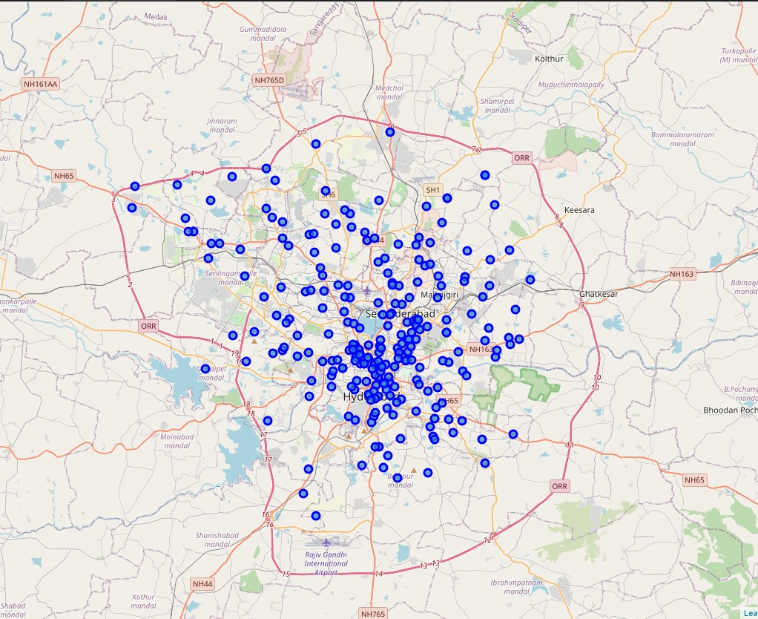
Methodology
We use folium library to produce a map of the Hyderabad layout with the neighborhoods marked in as blue dots.

Slide 7
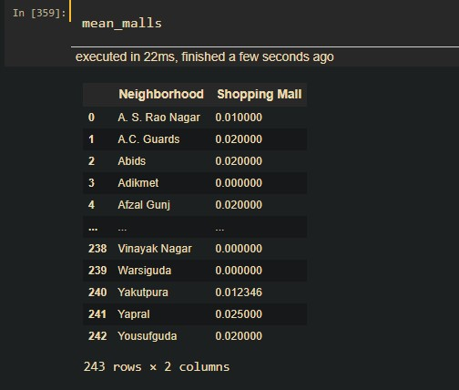
Data Wrangling
Now we analyze the neighborhood by one hot coding the categorical values of the venues. This prepares the data for further clustering analysis we do.
After one hot encoding, we extract only the venue values of shopping mall as that is what we are interested in.

Slide 8
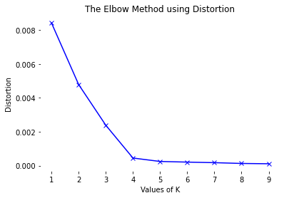
Clustering Using K-Means
We use, k-means clustering algorithm in order to cluster similar neighborhoods based on the mean shopping malls values. Before we carry on with this, an optimal value for k has to be obtained for the achieving best performance model.
Elbow method is used here for k values ranging from 1 to 10 and a graph is plotted.
As evident, the value of 3 for k is most suitable for this scenario

Slide 9
Clustering Using K-Means
We use, k-means clustering algorithm in order to cluster similar neighborhoods based on the frequency of shopping malls occurrence.
Before we carry on with this, an optimal value for k has to be obtained for the achieving best performance model.
Elbow method is used here for k values ranging from 1 to 10 and a graph is plotted.
As evident, the value of 4 for k is most suitable for this scenario
We carry on with the k-means clustering, with k=4, and form a map with the help of folium library

Slide 10
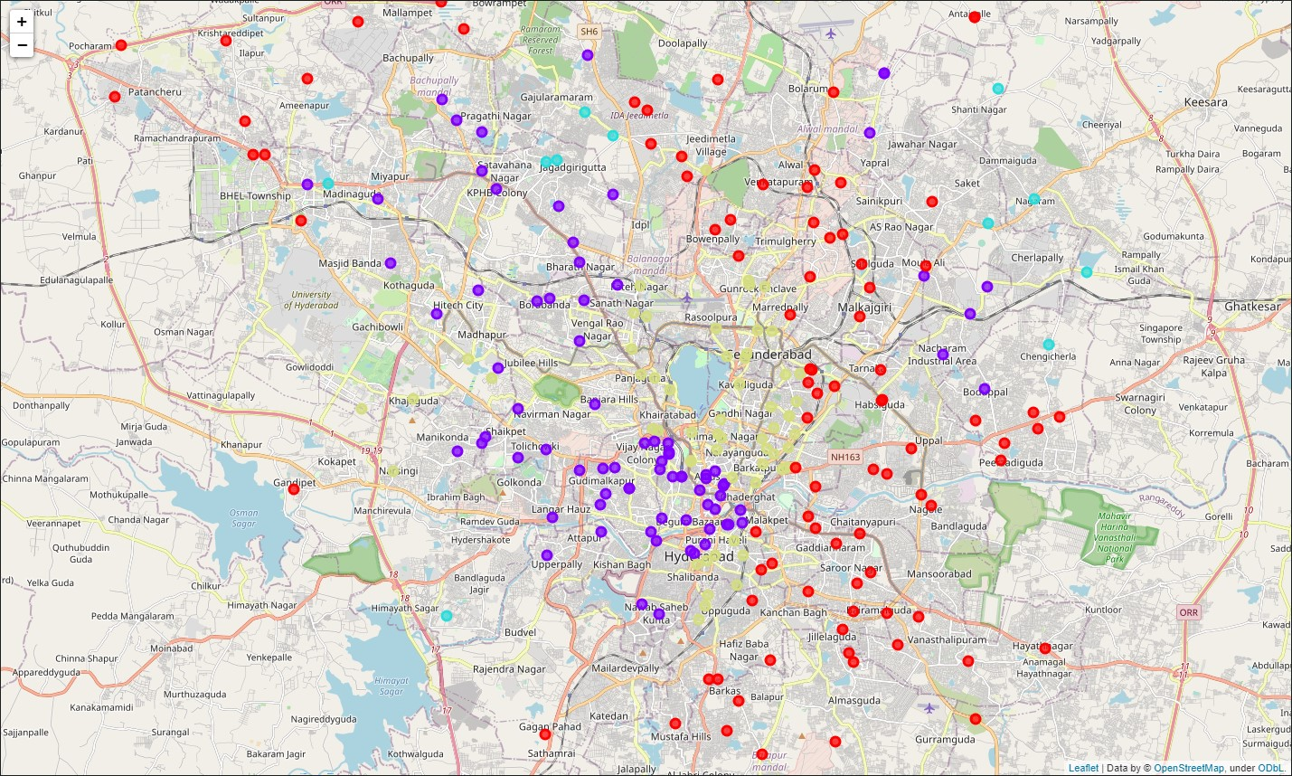
Clusters Map

Slide 11
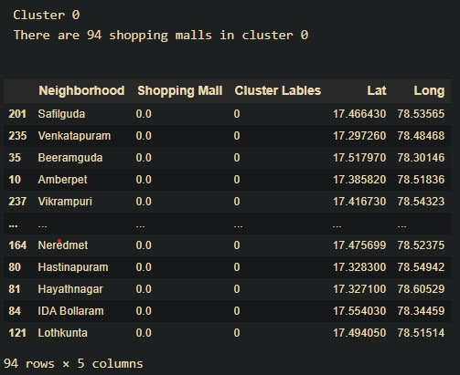
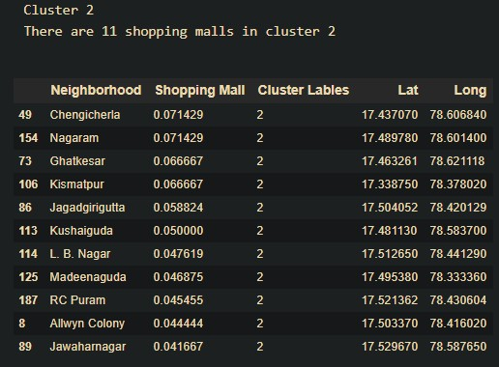
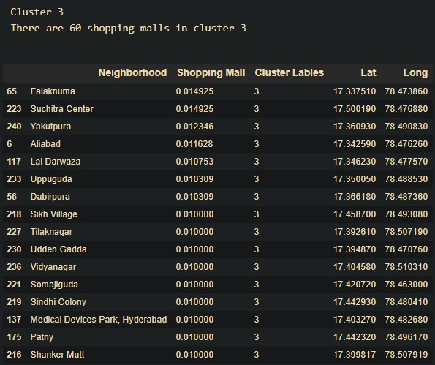
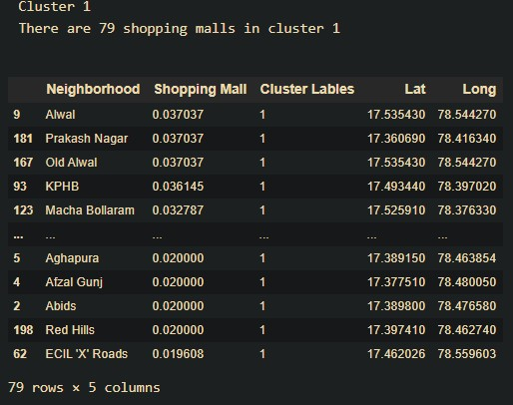
Results
4 clusters are formed with the following characteristics;
Cluster 0 (Red Color): Neighborhoods with almost no shopping malls in 94 localities
Cluster 1 (Purple Color): Neighborhoods with moderate number shopping malls in 79 localities
Cluster 2 (Blue Green Color): Neighborhoods with high number shopping malls in 11 localities
Cluster 3 (Dull Green Color): Neighborhoods with low number of shopping malls in 60 localities

Slide 12
Discussions
As observations noted from the map in the Results section, a considerable amount of shopping malls is concentrated around the left part or western part of the city, with the highest number in cluster 1 and a few in cluster 2.
On the other hand, cluster 0 and cluster 3 have almost none or very low number shopping malls in their neighborhoods which represents a great opportunity and high potential areas to open new shopping mall.
And with the cluster 0 and cluster 3 being concentrated mostly over the eastern part of the city, having a good number of national highways going through them, they are a strong locality to consider.
Conclusion
To answer the business question that was raised in the introduction section, the answer proposed by this project is: The neighborhoods in cluster 0 and cluster 3 are the most preferred locations to open a new shopping mall. The findings of this project will help the relevant stakeholders to capitalize on the opportunities on high potential locations while avoiding overcrowded areas suffering from high competition

